Slide 1
Systems Analysis and Design
Week 1-2
Analyzing the Business Case

Slide 2

Chapter Objectives
Explain
Explain the concept of a business case and how a business case affects an IT project
Describe
Describe the strategic planning process and why it is important to the IT team
Conduct
Conduct a SWOT analysis and describe the four factors involved

Slide 3

Chapter Objectives
Explain the purpose of a mission statement
Explain how the SDLC serves as a framework for systems development
List the reasons for systems projects and factors that affect such projects

Slide 4

Chapter Objectives
Describe systems requests and the role of the systems review committee
Define operational, technical, economic, and schedule feasibility
Describe the steps and the end product of a preliminary investigation

Slide 5
Introduction
The term business case refers to the reasons, or justification, for a proposal
A strong business case suggests that the company should pursue the alternative, above other options, because it would be in the firm’s best interest to do so
Systems development typically starts with a systems request, followed by a preliminary investigation, which includes a feasibility study

Slide 6
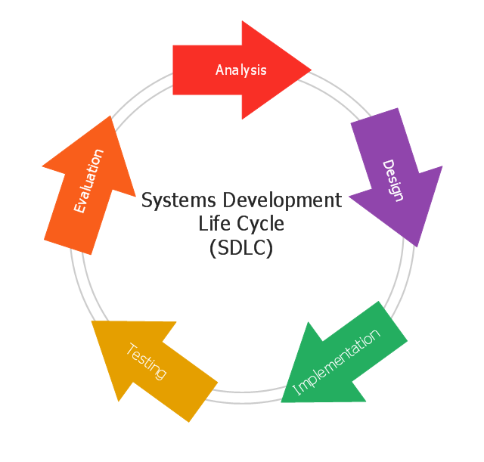
Step 1 - SDLC
1. Analyze the request
2. Prepare the preliminary Investigation Report
3. Prepare the Requirements (Business & System Requirements which gather from end users) Analysis Report
Step-by-step process for developing high-quality information systems
Output: Technical Specification Report
No Code Here ☺
Responsible Person:
System/Business Analyst
Experienced Developer(s) & Tester(s)
Expert(s)
Monitoring; Implementation & Support
GUI Design (Front-End Design)
2. Back-End Design
1. System & Sub-system Design
2. System Model Preparation using UML Diagrams & ER Diagrams for Front-End & Back-End of product, that developers can understand
Prepare Manual & Automated Use Cases, Test Cases & Test Scripts for all Test Phases

Slide 7
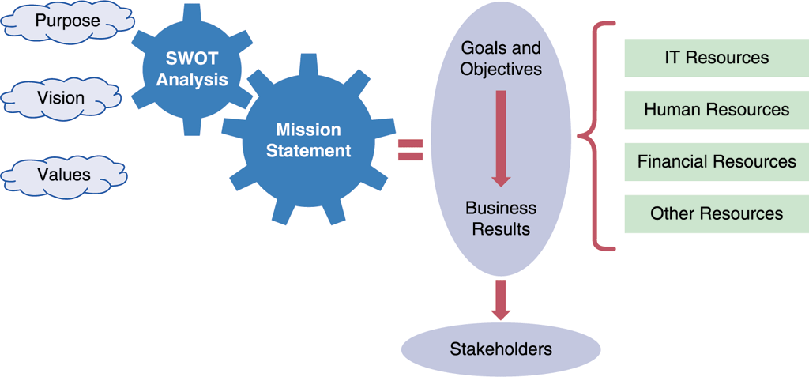
Strategic Planning – A Framework for IT Systems Development
From Strategic Plans to Business Results
Mission statement
Stakeholders
Goals
Objectives
Strategic planning is the process of identifying long-term organizational goals, strategies, and resources. Looks beyond day to day activities & focuses 3, 5 or 10 years in the future.
Systems analysts should focus on the larger, strategic role of IT even as they carry out their day-to-day technical tasks
Mission statements usually focus on long-term challenges and goals, the importance of the firm’s stakeholders, and a commitment to the firm’s role as a corporate citizen.

Slide 8
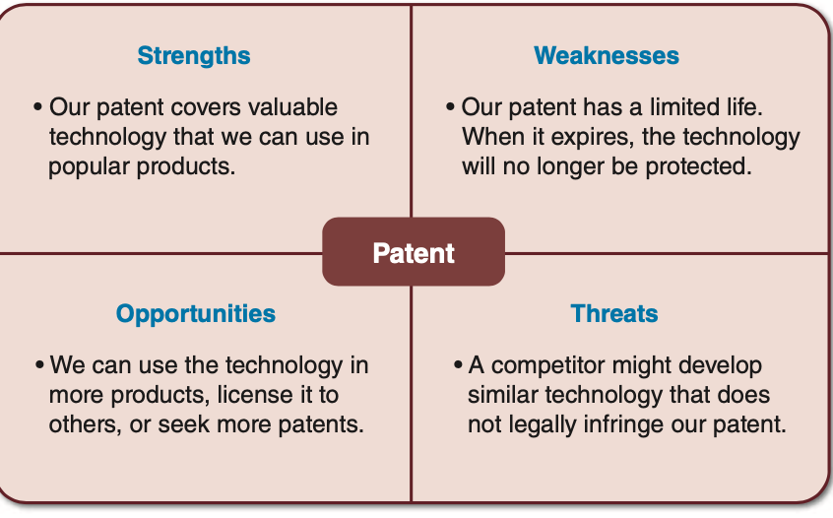
Strategic planning for it projects
SWOT analysis can focus on a specific product or project, an operating division, the entire company, or the mission statement itself. The overall aim is to avoid seeking goals that are unrealistic, unprofitable, or unachievable.
What are our strengths, and how can we use them to achieve our business goals?
What are our weaknesses, and how can we reduce or eliminate them?
What are our opportunities, and how do we plan to take advantage of them?
What are our threats, and how can we assess, manage, and respond to the possible risks?
Experienced analysts know that planning is essential for IT project success, and it must start as early as possible.
Careful planning can help assure that:
The project supports overall business strategy and operational needs.
The project scope is well defined and clearly stated.
The project goals are realistic, achievable, and tied to specific statements, assumptions, constraints, factors, and other inputs.
Figure 2-2 This SWOT analysis example focuses on a specific asset: a company patent.

Slide 9
Strategic Planning-A Framework for IT Sys. Dev.
From Strategic Plans to Business Results
Mission Statement
A document or statement that describes the company for its stakeholders and briefly states the company's overall purpose, products, services, and values.
Stakeholders
Anyone who is affected by the company's performance, such as customers, employees, suppliers, stockholders, & members of the community.
Goals
Goals support the accomplishment of a mission. (in terms of years)
Objectives
Objectives support the goals. They generally have a shorter time frame than goals, and might include tactical plans.

Slide 10
Strategic Planning – A Framework for IT Systems Development
A CASE Tool
You are a systems analyst
You research the Visible Analyst CASE tool
Planning statements can include assumptions, goals, objectives, and critical success factors, and many other types of statements
Each company use specific case tools
You can use MS Visio and/or search (free) alternatives on internet
Some developers stick to traditional text- based methods, using Microsoft Word tables to provide structure and clarity. Others prefer a spreadsheet, such as Microsoft Excel, because it is easy to display priorities and the relative importance of planning assumptions. However, another approach is to use a computer-aided systems engineering (CASE) tool to define and document the overall environment (please read chapter 2, page 43, CASE in Point 2.1: Lo Carb Meals - on our main book).

Slide 11
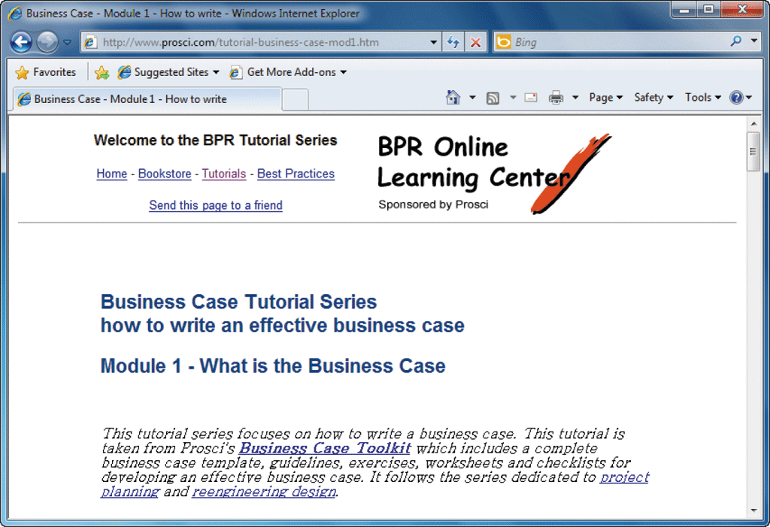
What Is a Business Case?
Business Case – start with Request form and continue with Preliminary Investigation Report
the term business case refers to the reasons, or justification, for a proposal. A business case should be comprehensive yet easy to understand. It should describe the project clearly, provide the justification to proceed, and estimate the project’s financial impact.
The business case should answer questions such as the following:
Why are we doing this project?
What is the project about?
How does this solution address key business issues?
How much will it cost and how long will it take?
Will we suffer a productivity loss during the transition?
What is the return on investment and payback period?
What are the risks of doing the project? What are the risks of not doing the project?
How will we measure success?
What alternatives exist?
Examples of business cases, both good and bad, can be found online and/or analyze sample Final Report (SAD Course Final Project Template) on LMS. Just search for “sample business case”

Slide 12
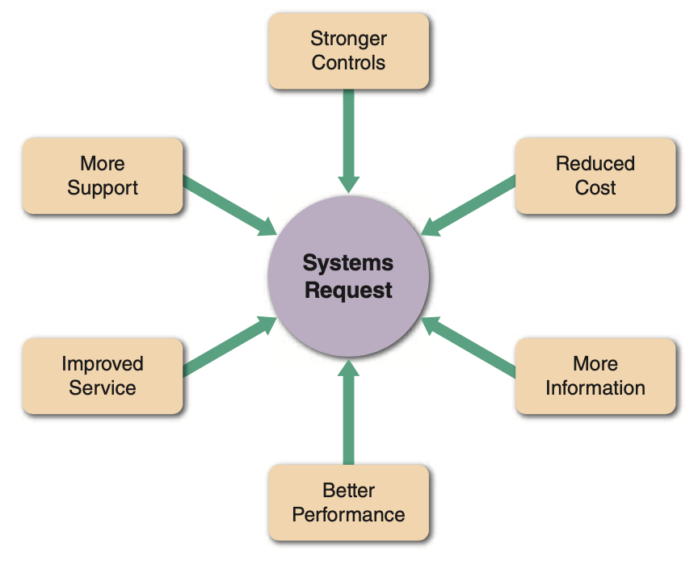
Information Systems Projects
The starting point for most projects is called a systems request, which is a formal way of asking for IT support. A systems request might propose enhancements for an existing system, the correction of problems, the replacement of an older system, or the development of an entirely new information system that is needed to support a company’s current and future business needs.
Systems request
Improved service
Improve customer satisfaction
Better performance
Slow output / response
Changing hardware/software specification
More information
Increase information to be produced
Stronger controls
Effective controls, data secure & accurate
Security control→ password, level of user access, encryption, device
Reduced cost
Maintaining the current system is high.
The new system would be cheaper
Support for New Product
Changing to new technology

Slide 13
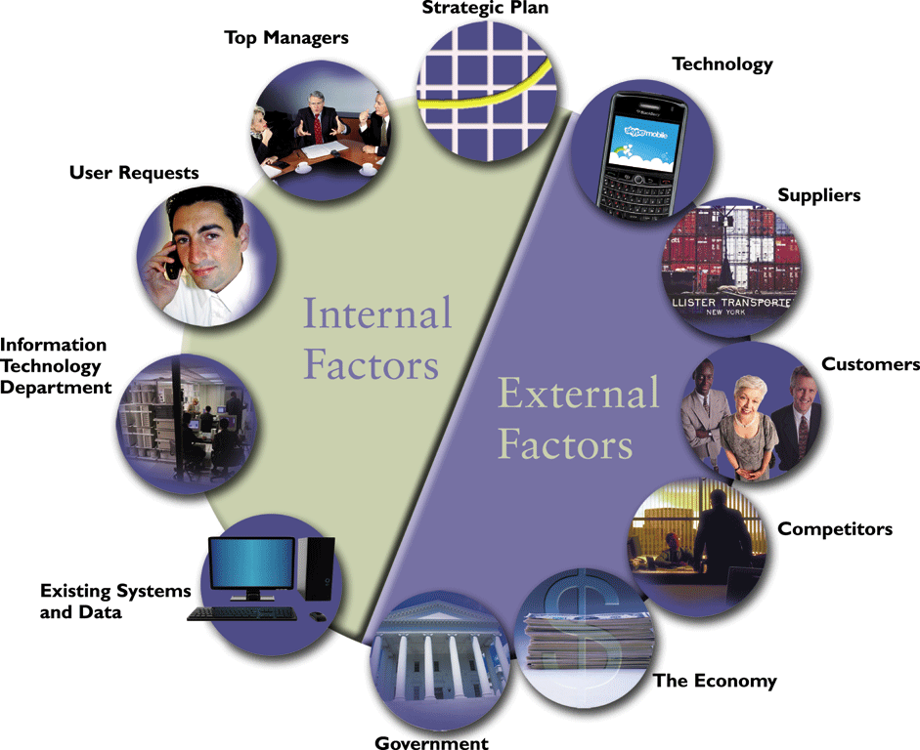
Information Systems Projects
Internal and external factors affect every business decision that a company makes.
directive comes from strategic business decision, decision making
overall direction, objectives, goal
Internal system users wants a better system to increase his/her productivity
Changing tech. → reshape the existing business
Relationship with supp.
manage all cust. related events & transaction;top priority.
Request & recommendation from the department itself
Offer / Decision of the competitors
Problems / errors with current system→ request new sys.
In a period of economic expansion, firms need to be ready with scalable systems that can handle additional volume and growth.
government regulations directly affect the design of corporate information systems
Factors that Affect Systems Projects

Slide 14
Evaluation of System Request
Sys Request Forms
User
Receive Sys Request
IT Department
Evaluate the Sys. Request
Sys. Review Committee OR Comp. Resource Committee
To study if the request is worth
Set priorities
IT manager
Other Department manager

Slide 15
Evaluation of System Request
Whether one person or a committee is responsible, the goal is to evaluate the requests and set priorities.
Suppose five requests must be reviewed:
The marketing group wants to analyze current customer spending habits and forecast future trends. So they need a new software (application) or to upgrade old one.
The technical support group wants a cellular link so service representatives can download technical data instantly. They need a new ERP software
The accounting department wants to redesign customer statements and allow Internet access.
The production staff wants an inventory control system that can exchange data with major suppliers.
Financial Department needs a new software product
Which projects should the firm pursue? What criteria should be applied? How should priorities be determined? To answer these questions, the individual or the committee must assess the feasibility of each request.

Slide 16
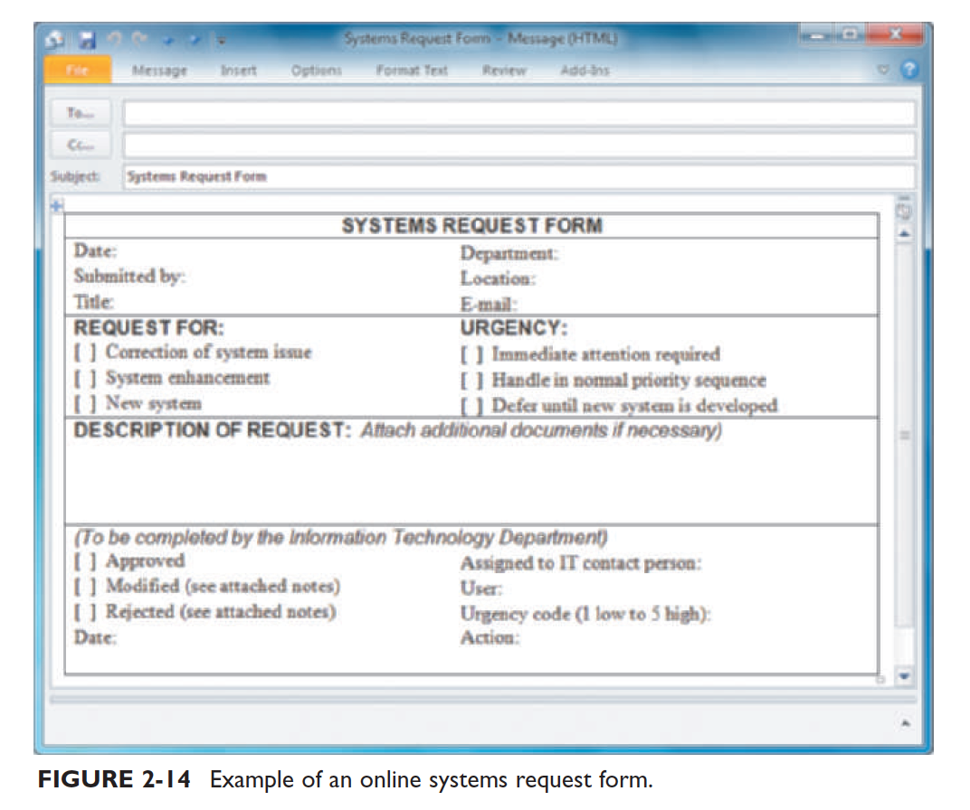
Systems Request Forms
Many organizations use a special form for systems requests, similar to the online sample
shown in Figure 2-14.

Slide 17
Evaluation of Systems Requests
Systems Review Committees
Most large companies use a systems review committee to evaluate systems requests
Many smaller companies rely on one person to evaluate systems requests instead of a committee (Business/System Analyst)
The goal is to evaluate the requests and set priorities

Slide 18
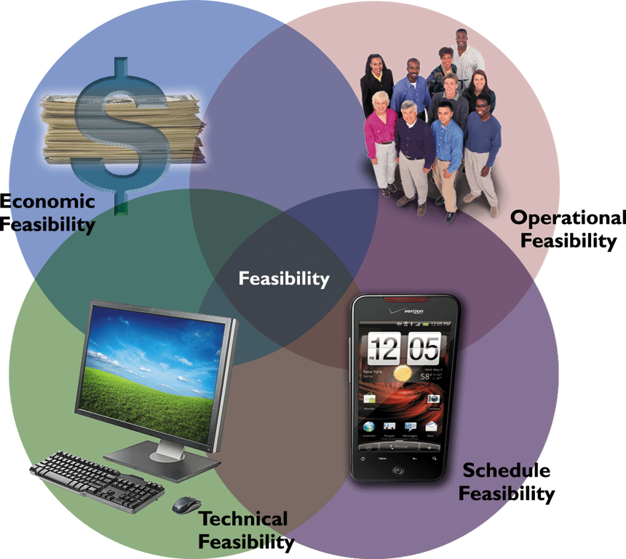
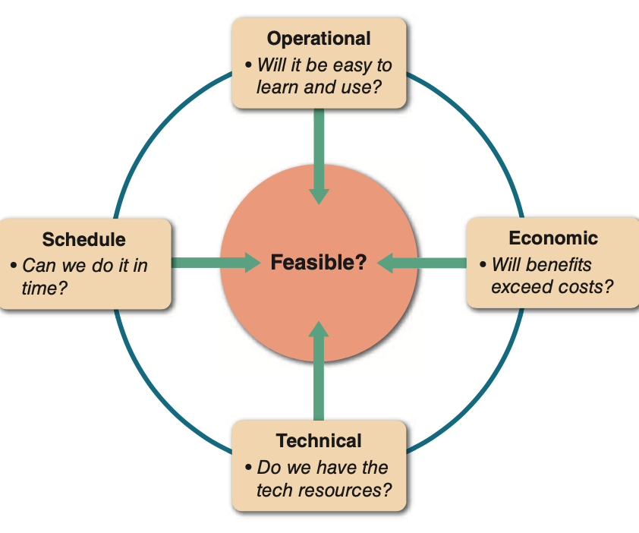
Overview of Feasibility
A systems request must pass several tests, called a feasibility study, to see whether it is worthwhile to proceed further

Slide 19
Evaluation of System Request
System Request must pass several test
Feasibility Study
schedule
Can the project be completed within the given period of time.
operational
would a proposed system be used effectively after it has been developed
economic
Total cost of ownership (TCO) – determine the direct & indirect costs
Overall cost (maintenance cost + licenses cost +consulting+training)
technical
refers to technical resources needed to develop, purchase, install, or operate the system

Slide 20


Setting Priorities
Factors (fact finding) that Affect Priority
Will the proposed system reduce costs? Where? When? How? How much?
Will the system increase revenue for the company? Where? When? How? How much?

Slide 21

Setting Priorities
Factors (fact finding) that Affect Priority
Will the systems project result in more information or produce better results? How? Are the results measurable?
Will the system serve customers better?
Will the system serve the organization better?

Slide 22

Setting Priorities
Factors (fact finding) that Affect Priority
Can the project be implemented in a reasonable time period? How long will the results last?
Are the necessary financial, human, and technical resources available?

Slide 23
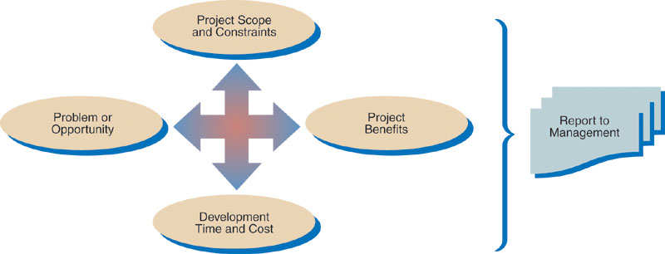
Preliminary Investigation Overview
An initial investigation to clearly identify the nature & scope of the business opportunity or problem. (Business/System Analyst interact with Manager & User & IT Staff)
(Factors)
Fact
Finding
The analyst gathers facts about the problem or opportunity, project scope and constraints, project benefits, and estimated development time and costs.

Slide 24
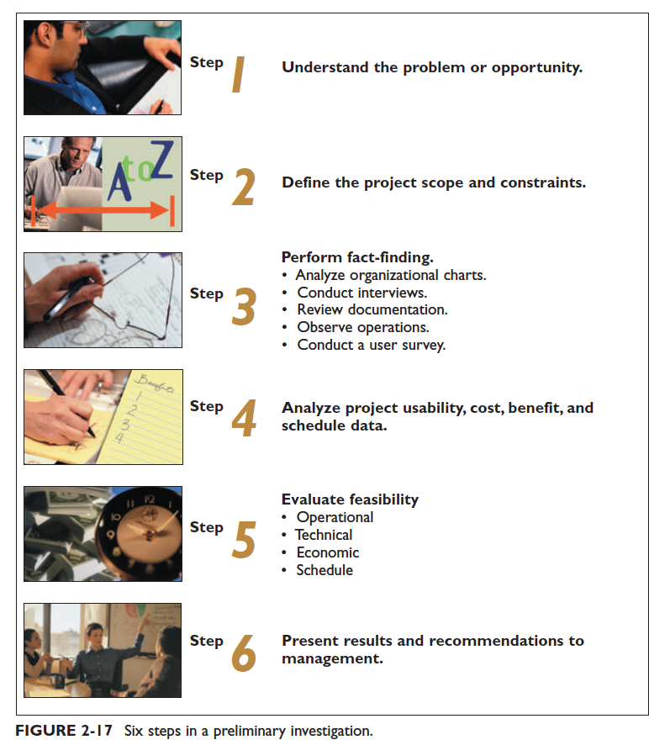
Planning the Preliminary Investigation
During a preliminary investigation, a systems analyst typically follows a series of steps,
as shown in Figure 2-17. The exact procedure depends on the nature of the request, the
size of the project, and the degree of urgency.

Slide 25
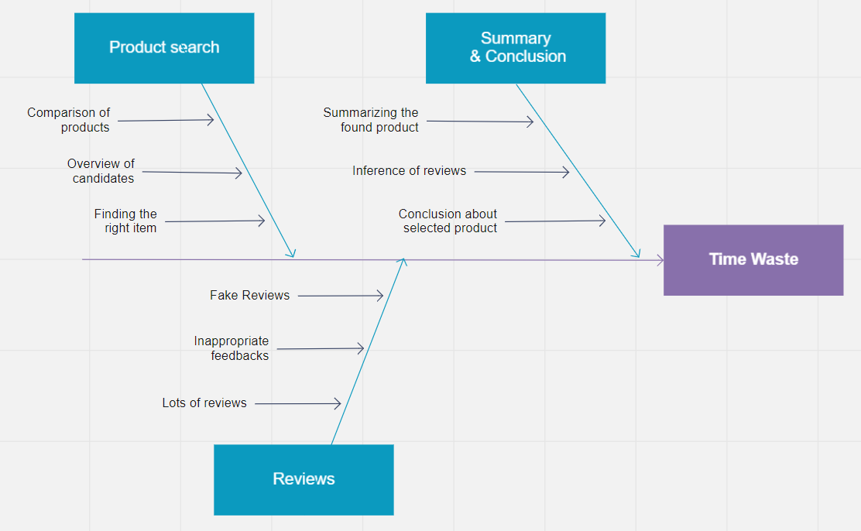
Preliminary Investigation Overview
Step 1: Understand the Problem or Opportunity
A popular technique for investigating causes and effects is called a fishbone diagram, or Ishikawa diagram. It is an analysis tool that represents the possible causes of a problem as a graphical outline
Determine which departments, users,& business processes are involved
Sample

Slide 26
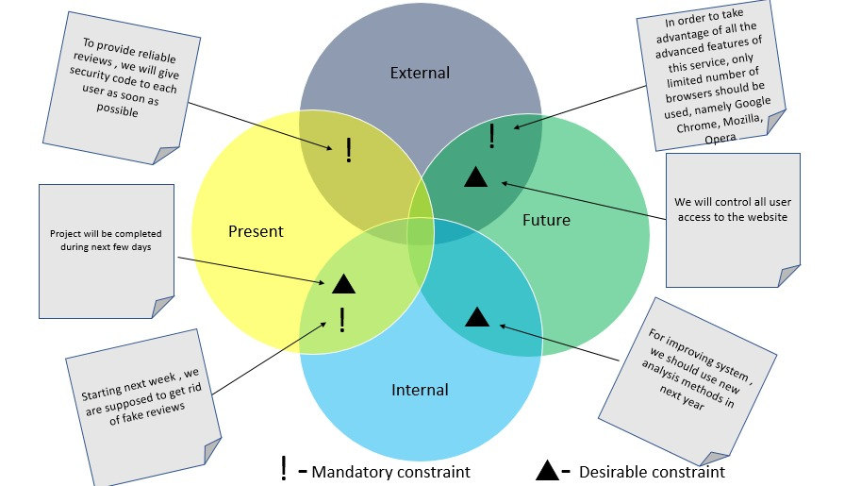
Preliminary Investigation Overview
Step 2: Define the Project Scope and Constraints
Project scope - a specific determination of a project's boundaries or extent.
Constraint - a condition that the system must satisfy or an outcome that the system must achieve. Can be in terms of hardware, software, policy, law or cost.
Sample
Types of constraints
From SAD Course Final Project Template.docx
Scope of this project is mainly about designing database which stores processed summaries of reviews. Apart from that, it is also possible to retrieve needed information and data from that database. In details, it will be much faster if the needed information is formerly processed and stored in database. However, it will obviously take some time to process raw reviews in order to retrieve summary in the end. Coming to the constraints of the project, first and foremost, project must be completed within budget tolerance. Additionally, project deliverables must be completed in the course of one year. Furthermore, in order to take advantage of all the advanced features of this service, only limited number of browsers should be used, namely Google Chrome, Mozilla, Opera. …

Slide 27
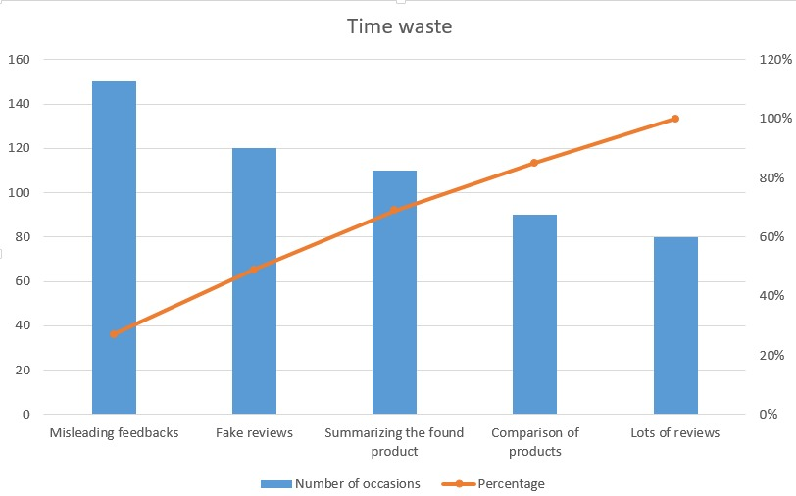
Preliminary Investigation Overview
Step 3: Perform Fact-Finding
Analyze organization charts
Conduct Interviews
Review documentation
Observe operations
Conduct a user survey
Prep. MeMo’s
Interview Steps:
1. Determining people to interview.
2. Asking for some needed information related to the projects.
3. Evaluation of answers of questions during interview and results.
4. Documentation process of interview.
Sample
Based on our recent survey, significantly large percentage of people said that, they definitely read reviews whenever they are about to purchase. Even though most people prefer to read others’ feedbacks about a particular product, our findings clearly show that there are bunches of fake or useless reviews that mislead desperate customers. Because of this unfortunate reality, our algorithms will firstly identify and subtract fake reviews from real ones, then start to process and summarize needed information which are based on real feedbacks.
Survey
From SAD Course Final Project Template.docx

Slide 28
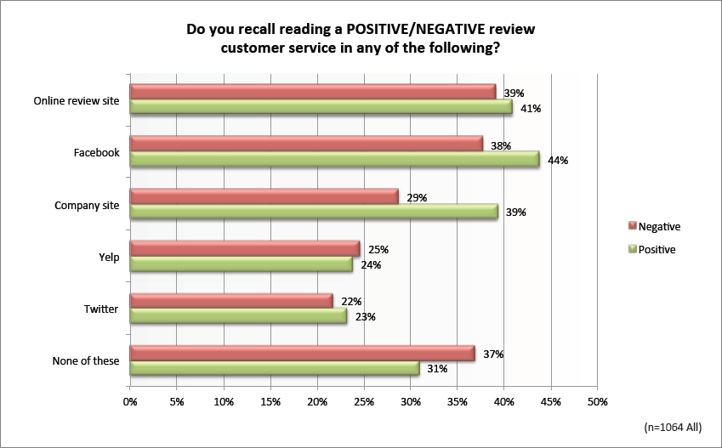
Preliminary Investigation Overview
Step 4: Analyze Project Usability, Cost, Benefit, and Schedule Data
Before you can evaluate feasibility, you must analyze this data carefully (Data that has been gathered from fact finding has to be analyzed before you can evaluate feasibility)
What information must you obtain, and how will you gather and analyze the information?
What sources of information will you use, and what difficulties will you encounter in obtaining information?
Will you conduct interviews? How many people will you interview, and how much time will you need to meet with the people and summarize their responses?
Will you conduct a survey? Who will be involved? How much time will it take people to complete it? How much time will it take to prepare it and tabulate the results?
How much will it cost to analyze the information gathered and to prepare a report with findings and recommendations?
Sample
Thousands of people use this service around the globe – Our service is popular around the world. Already existed review service like our project has been widely used especially over the last decade due to the rise in the popularity of online shopping. …
From SAD Course Final Project Template.docx

Slide 29
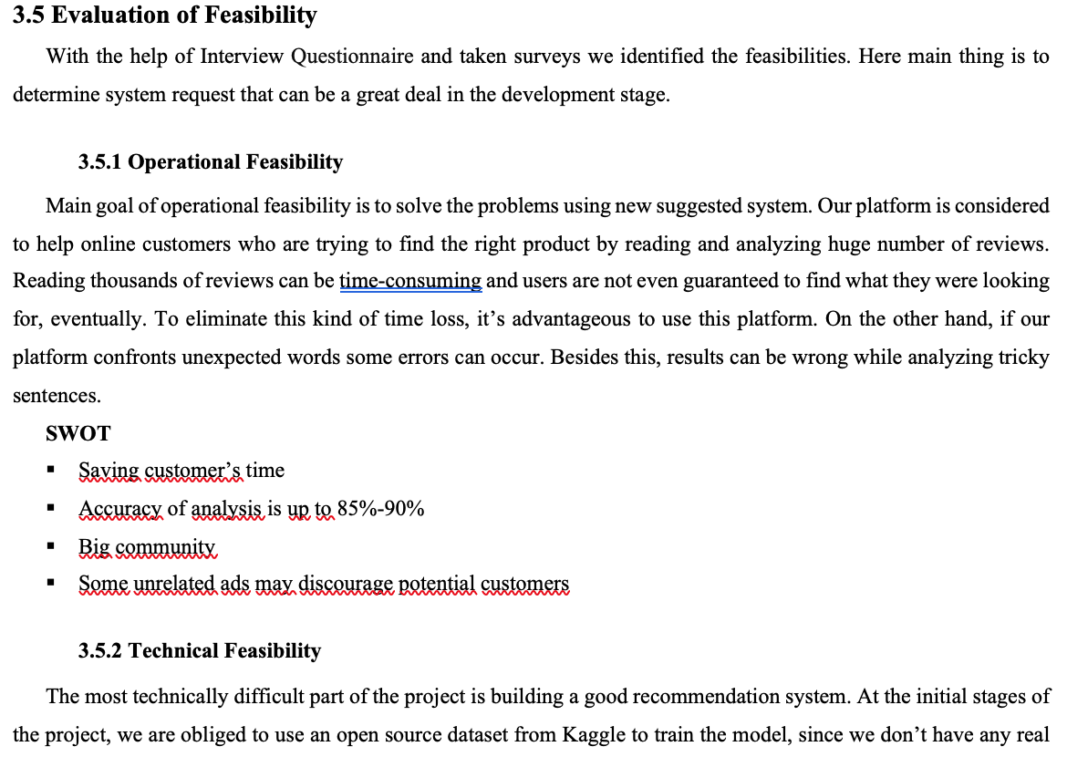
Preliminary Investigation Overview
Step 5: Evaluate Feasibility
Start by reviewing the answers to the questions you asked
Operational feasibility
Technical feasibility
Economic feasibility
Schedule feasibility
From SAD Course Final Project Template.docx
Sample

Slide 30
Preliminary Investigation Overview
Step 6: Present Results and Recommendations to Management
The final task in the preliminary investigation is to prepare a report to management
The format of the preliminary investigation report varies from one company to another
Introduction
Systems request summary
Findings
Recommendations
Time & cost estimates
Expected benefits
Appendix
Preliminary
Investigation
Report

Slide 31
HW
*** For Week 2 - Announcements
Read and analyze Chapter 2 section (from the main Book)
Do assignment (for week2) on LMS system till deadline (download, do, upload till deadline), check LMS
Finish Business Case of your project (Request Form + Preliminary Investigation Report) till deadline (check LMS)

Slide 32
Chapter Summary
Strategic planning allows a company to examine its purpose, vision, and values and develops a mission statement, which leads to goals, objectives, day-to-day operations, and business results that affect company stakeholders
Systems projects are initiated to improve performance, provide more information, reduce costs, strengthen controls, or provide better service

Slide 33
Chapter Summary
Various internal and external factors affect systems projects, such as user requests, top management directives, existing systems, the IT department, software and hardware vendors, technology, customers, competitors, the economy, and government
During the preliminary investigation, the analyst evaluates the systems request and determines whether the project is feasible from an operation, technical, economic, and schedule standpoint

Slide 34
Chapter Summary
Analysts evaluate systems requests on the basis of their expected costs and benefits, both tangible and intangible
The steps in the preliminary investigation are to understand the problem or opportunity; define the project scope and constraints; perform fact-finding; analyze project usability, cost, benefit, and schedule data; evaluate feasibility; and present results and recommendations to management

Slide 35
Chapter Summary
The last task in a preliminary investigation is to prepare a report to management
The report must include an estimate of time, staffing requirements, costs, benefits, and expected results for the next phase of the SDLC
Chapter 2 complete

